Slide 1

Structure and union

Slide 2

Arrays allow to define type of variables that can hold several data items of the same kind.
Similarly structure is another user defined data type available in C that allows to combine data items of different kinds.
Structures are used to represent a record.

Slide 3
Suppose you want to keep track of your books in a library. You might want to track the following attributes about each book −
Title
Author
Subject
Book ID

Slide 4

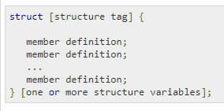
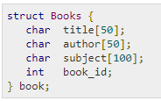
To define a structure, you must use the struct statement. The struct statement defines a new data type, with more than one member.

Slide 5
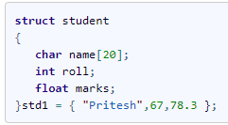
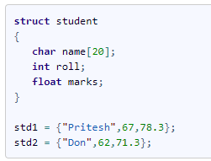
Structure Initialization
Way 1 : Declare and Initialize
Way 2 : Declaring and Initializing Multiple Variables

Slide 6
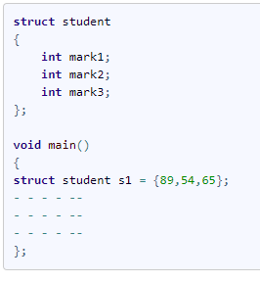
Way 3 : Initializing inside main

Slide 7

To access any member of a structure, we use the member access operator (.).
The member access operator is coded as a period between the structure variable name and the structure member that we wish to access.
You would use the keyword struct to define variables of structure type.

Slide 8
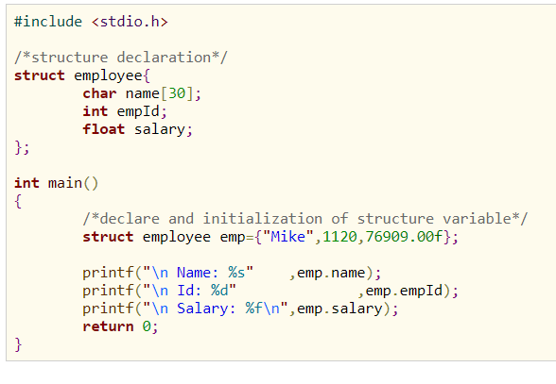


Slide 9

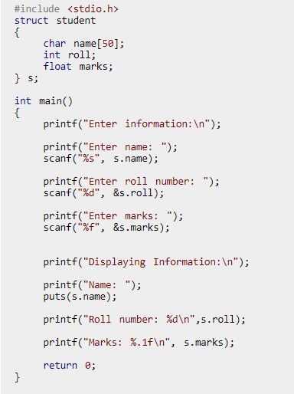
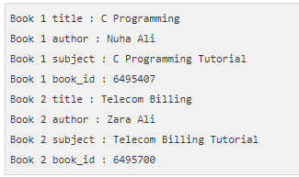

Slide 10

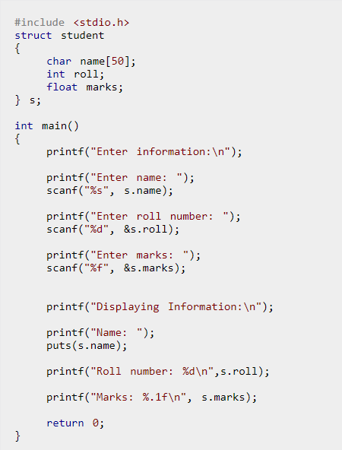

Slide 11

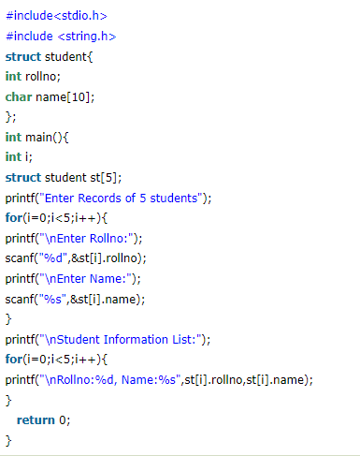

Slide 12

A union is a special data type available in C that allows to store different data types in the same memory location.
You can define a union with many members, but only one member can contain a value at any given time.
Unions provide an efficient way of using the same memory location for multiple-purpose.

Slide 13

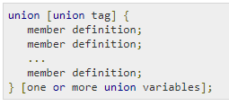
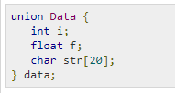
To define a union, you must use the union statement. The union statement defines a new data type with more than one member for your program.

Slide 14

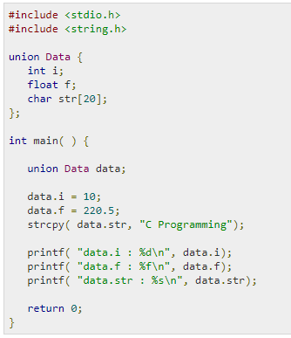
Only one union member can be accessed at a time

Slide 15

Here, we can see that the values of i and f members of union got corrupted because the final value assigned to the variable has occupied the memory location and this is the reason that the value of str member is getting printed very well.

Slide 16
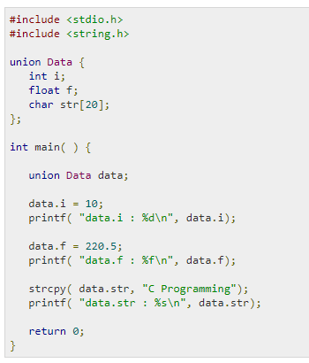

Here we will use one variable at a time which is the main purpose of having unions −

Slide 17
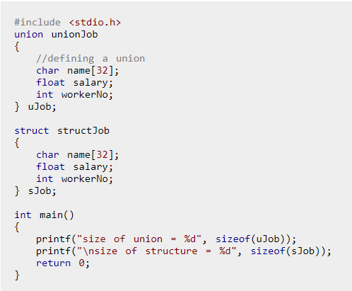

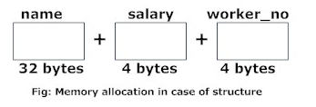
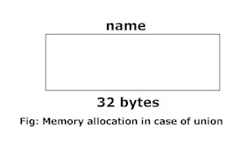
More memory is allocated to structures than union

Slide 18

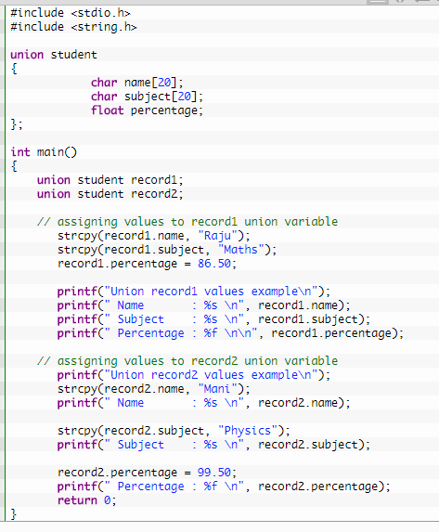
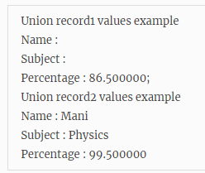

Slide 19
